Slide 1


Slide 2



1. What is open redirection
2. Impact of open redirection
3. How to find open redirection
4. Live Demo

Slide 3
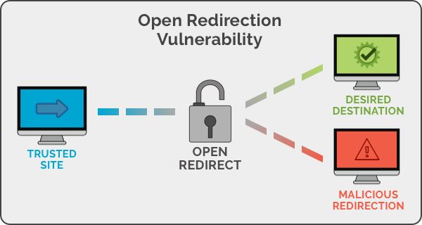
What is open redirection
Open redirection vulnerabilities arise when an application incorporates user-controllable data into the target of a redirection in an unsafe way. An attacker can construct a URL within the application that causes a redirection to an arbitrary external domain.
This behavior can be leveraged to facilitate phishing attacks against users of the application.

Slide 4
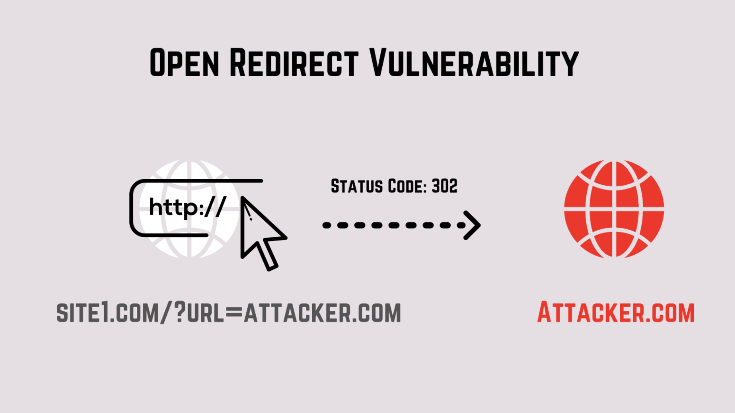
Impact of open redirection
Phishing: The most obvious way to use an open redirect is to steer the victim away from the original site to a site that looks the same, steal user credentials, and then return to the vulnerable website as if nothing happened.
Cross-site Scripting (XSS): If the redirect allows the use of data: or javascript: protocols and the client supports such protocols in redirects, it makes it possible for the attacker to perform an XSS attack.
Server-Side Request Forgery (SSRF): Open redirects may be used to evade SSRF filters.
Content-Security-Policy bypassing: If you use CSP to protect against XSS and one of the whitelisted domains has an open redirect, this vulnerability may be used to bypass CSP.
CRLF Injection: If the redirection parameter allows line breaks, the attacker may try to perform response header splitting.

Slide 5
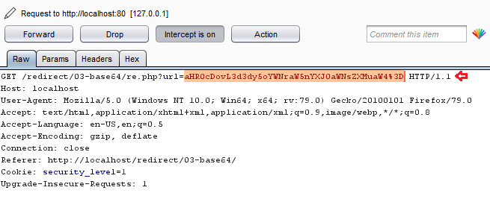
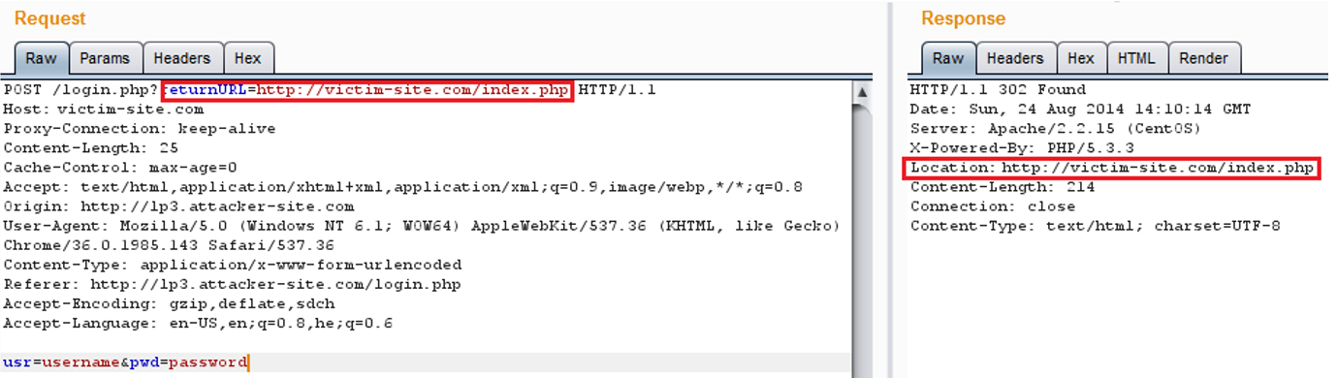
How to find open redirection
Search for URL redirection On GET Requests:
When searching for these types of vulnerabilities you're looking for a GET request sent to the site you're testing with a parameter specifying a URL to redirect.

Slide 6
The parameters to check for in the URL:
red=
link=
ret=
page=
r2=
q=
img=
url=
u=
redirect=
return=
end_display=
r=
url=
URL=
location=
Next=
toredirect=
ReturnUrl=
redirectBack=
page=
AuthState=
uri=
Referer=
path=
redir=
referrer=
l=
file=
aspxerrorpath=
returnUrl=
image_path=
redirect_url=
ActionCodeURL=
forward=
return_url=
open=
newurl=
file=
From=
langTo=
rb=
Goto=
old=
back=

Slide 7
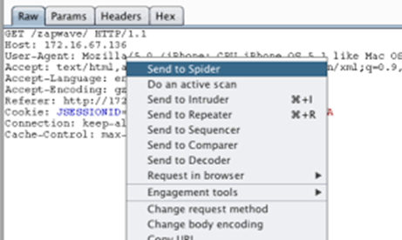
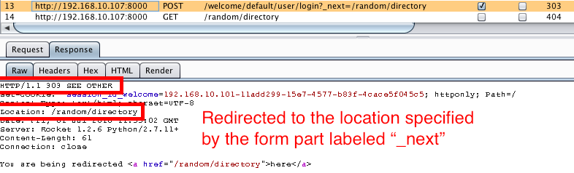
Examine if the URL is vulnerable to open redirect:
Find out the above parameters by spidering the site
Change the parameter and forward the request.
If you get redirected to the URL which you added it is a vulnerability.

Slide 8

Example URL which will be vulnerable for open redirect:
Here the “ReplyState” parameter needs to be checked for open redirect.
https://www.example.com/login.html?ReplayState=http%3A%2F%2Fexample.com%2Fnext
Google Dorking techniques:
Allinurl:
Example: allinurl:ReturnUrl which searches for web pages that have "ReturnUrl" as part of their URL
Site:
Example: site:example.com which searches for web pages from example.com

Slide 9
Open Redirect Cheatsheets:
https://github.com/EdOverflow/bugbounty-cheatsheet/blob/master/cheatsheets/open-redirect.md
https://www.openbugbounty.org/blog/devl00p/top-100-open-redirect-dorks/
https://www.openbugbounty.org/blog/miguelsantareno/google-dorks-to-find-open-redirects/

Slide 10
THANK YOU

